Slide 1
Gender-responsive forest tenure reforms?
Land and forest tenure: Implications for sustainable management and inclusion
23/09/20
Inclusive governance for sustainable landscapes
Lessons from Indonesia, Peru and Uganda
Iliana Monterroso Ibarra
Anne M. Larson, Nining Liswanti, Tuti Herawati, Zoila Cruz-Burga, Abwoli Banana and Concepta Mukasa
Notes:
Research and practice argue that Improving tenure security for land and forests will lead to sustainable management and support livelihoods of forest-dependent peoples. During the last 40 years important efforts to formalize rights to forests and land have taken place specially in collective tenure regimes. Yet little attention has been paid to the question of whether women and men share equally in the benefits of formalizing collective tenure rights. This presentation will discuss under which conditions reforms can lead to better outcomes for women and other marginalized groups. In sum, how can we arrive to gender responsive tenure reforms.
40

Slide 2
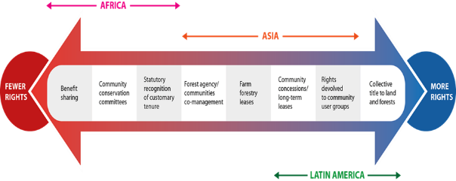
Forest Tenure Reforms: Gender responsive?
Most forest lands are owned and administered by the state
Latin America - 59%
Africa 92%
Asia 62%
Source: RRI, 2018:18
Notes:
Globally, most forests lands are owned and administered by the state with a steady process of rights recognition under collective tenure regimes using different institutional mechanisms ranging from collective tiltes to land to benefit sharing mechanisms to access forest resources.
When we talk about forest tenure reform we refer to changes in regulations that define the rights over who uses, manages and control forest resources. This refers to the bundle of rights but also to the security of these rights: whether the law formally recognizes the rights, whether we perceive those rights as secure and whether we feel confident our rights will be protected and enforced
23

Slide 3
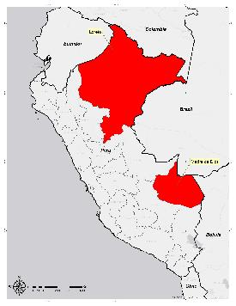
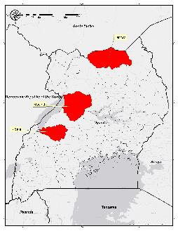
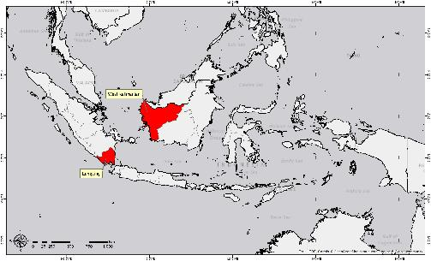
Study Areas and Methods
Publication on results available at
https://www.cifor.org/knowledge/publication/7440/
Peru
Uganda
Indonesia
Notes:
This presentation leverages on data collected by the Global Comparative Study on Forest tenure reforms. It focuses on data collected in 7 subregions and 41 sites in Peru, Uganda, and Indonesia. We analyzed seven types of reforms across three tenure regimes. Our analysis here is based only on those who participated in reforms.
In some cases, this included forestlands – as in Peru where we analyzed formalization of indigenous communities in the Amazon. In others, our analysis included processes where rights are not recognized to lands but rather forests resources. This is the case of social forestry schemes and partnerships in Indonesia and also Collaborative Forest Management and Community Forestry in Uganda.
32
1. State lands designated for community use
Reform 1. Community Forests HKm in Lampung and West Kalimantan, Indonesia
Reform 2.Community Plantations HTR in Lampung, Indonesia
Reform 3. Collaborative Forest Management Masindi, Uganda
2. State lands designated for the use of companies
Reform 4. Community-company partnerships West Kalimantan and Lampung in Indonesia
3. Lands owned by indigenous peoples and communities
Reform 5. Community Forests Masindi, Uganda
Reform 6. Customary lands, formalized Lamwo, Uganda
Reform 7. Titled communities Loreto and Madre de Dios, Peru
When helpful, we included data from non-participants to enable comparisons.

Slide 4
Gender in design of reforms
Women participate very little in drafting (and implementation)
🚹 78% vs. 🚺 22%.
Gender is not considered an objective of the reform
✅Uganda 23%; ⁉️Peru and Indonesia less than 5%
Reforms targeting women
✅Uganda vs. Indonesia (poor) Peru (indigenous)
Implementation requires clear sectorial provisions and guidelines
International instruments that call for incorporating gender considerations in resource access and tenure
Status of design and implementation; green: indicates advanced, well developed, adequate or minimum statutory protection, well advanced implementation; orange: somehow effective, existing, under development, implementation with diverse levels of progress; red: unavailable, non-existent, underdeveloped, dysfunctional.
Notes:
Results show Important progress. Most countries have adopted international instruments and incorporated gender equality or equity principles in their national Constitutions. However specific provisions that determine whether women may own land and other resources are still lacking.
There is little participation of women or recognition of gender concerns in the objectives of reforms (Except for Uganda)
More men (78%) participate in desing and implementation in comparison to women (28%) (Larson et al., 2019a).
Therefore Implementation, requires clear sectorial provisions and guidelines indicating how men and women participate and benefit from the reform process
This means Mechanisms should indicate provisions for implementation that specify whether they encourage participation of women in decision-making; or promote changes in attitudes and behavior.
From the three countries the only targeted forest policies we found were in forest laws in Uganda and still their implementation in practice is limited.
52
attributes for each reform: a) who receives the rights to forest lands; b) the type of rights they receive and the length of time for which the rights are granted; c) the purpose of the reform and the steps to acquire rights; and d) the regulatory framework underpinning the reform.

Slide 5
Gender in implementation of reforms
Layers of rights
National policies
communal governance structures
household dynamics
Mechanisms of implementation should include clear provisions and clear practices
Reform’ goals
Subject’s of reforms (right-holders and right-granters)
Type of rights granted
Notes:
Participation of women and men in forest tenure reforms differs as it is defined in national policies, communal governance structures, as well as household dynamics. Therefore, we need to look at the factors favoring or hindering equal rights across these different levels.
Outcomes on the ground depend both on clear provisions and clear implementation practices. Having the law in place is not enough. Reform Goals should indicate how women, men and the different forest user groups will be incorporated in the implementation process and specify how they will benefit. For instance, national laws referred to “organized forest user groups” as subject’s of the reform. For Indonesia, representation is based on household head membership, understood mainly as men. In Uganda – participation is indivividual so both male and female can participate. In Peru membership is based on local norms that defines who is considered part of the community. Therefore, Identifying who is the subject of reforms, how women and men benefit, the type of rights and how these are distributed within the collective is important.
1.05

Slide 6
Outcomes of reform: Tenure Security
Factors influencing tenure security:
Socio-economic status
Undergoing reform
Participation in forest related organization
Rights to land and forest resources, are a key determinant of decision-making processes around forests.
Livelihood concerns are important aspects associated with satisfaction of rights and improved tenure security.
Notes:
Our results show that women’s perceptions of tenure security or insecurity are nested within the strength of collective rights. The bundle of rights formally recognized by the state for instance the differences in perception of women and men in sites where indigenous titles have been formalized in Peru or formalized customary lands in Uganda have a stronger perception of tenure security in comparison other social forestry schemes in Uganda and Indonesia. However, perceptions of tenure security are also embedded in the strength of individual’s rights and voice in the collective as it can be shown in the differences across how men and women perceived their rights as secured in customary lands in Uganda vs. indigenous lands in Peru
In the reforms analyzed, factors influencing positive perceptions around tenure security included whether respondents were non-poor, whether women were participating in villages undergoing reform processes and whether individuals are able to participate in forest related organizations.
This shows that It is not only about having rights but ensuring rights gained are secured as well as the ability to benefit from those rights in a sustained manner. Livelihood concerns are important aspects associated with the satisfaction of rights and improved tenure security. Continued assurance and support of productive systems and capacities of forest users to sustain outcomes after issuing forest certificates or permits and land titles is important.
1.08

Slide 7
Lessons for gender responsive reforms
Processes of rights devolution can influence internal debates on how existing rules affect men and women differently and allow new forms of organizing
☛ empowerment vs. social differentiation
☛ Participation of women does not equal sharing of rights, decisions and benefits
Institutional arrangements that are sensitive to women concerns and needs
☛ inclusive provisions and rules
☛ Improve management skills of the ”agents of implementation”
☛ Role of state or local governments, and social mobilization, whether for or against initiatives.
Reforms as dynamic processes
☛ information on implementation processes and practices
☛ Address livelihoods!‼️realization of rights and sustainability of outcomes
Notes:
From our results Three lessons for gender responsive reforms emerge
First our analysis shows there is no single type of reform that performs consistently better for men or for women. However, processes of rights devolution can influence internal debates on how existing rules affect men and women differently and allow new forms of organizing that could empower women. This keeps reforms from exacerbating social differentiation conditions, keeping in mind that participation of women (such as mapping exercises during demarcation processes) does not necessarily mean equal sharing of rights, decisions or benefits: We need to address power dynamics, and sources of inequality that remain.
Second, we need institutional arrangements that are sensitive to women concerns and needs. This means having gender responsive policies, laws, provisions and rules as well as norms and customary arrangements in place that are inclusive. These enable access, use and control of forest resources and influence decisions, collective choices, livelihood strategies, incentives for collaboration, investment and opportunities.
Third, reforms are dynamic processes, involving different feedbacks during design and implementation. We need to know Who is designing these reforms? Who is taking the decisions and participating in governance structures? Who are the agents of implementation? And what type of skills, and agency they have to influence decisions and support inclusive reforms.
Finally the realization of rights and the sustainability of outcomes derived from those rights is linked to the ability to improve livelihoods and secure those rights in the long term for women and men alike.
1.37

Slide 8
Thank you

